Slide 1
HMT 801 Travel Agency and Tour Operations
UNIT 4
Travel Entrepreneurship and Sustainable Marketing
Topic
Approaches for sustainable tourism development
Course Outcome (CO)
CO5: Evaluate the Sustainability of Travel operations and activities of travel bodies and associations

Slide 2
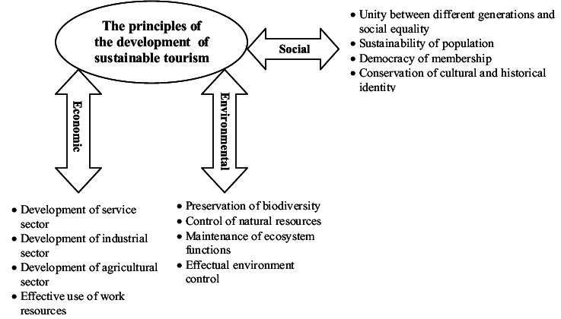
Approaches for Sustainable Tourism Development

Slide 3
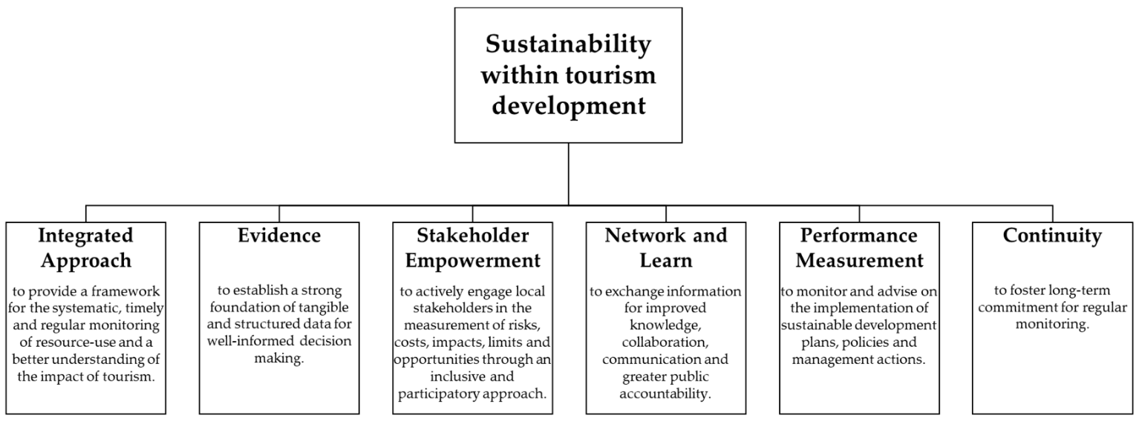
Objectives of sustainability within tourism development

Slide 4

SDG

Slide 5
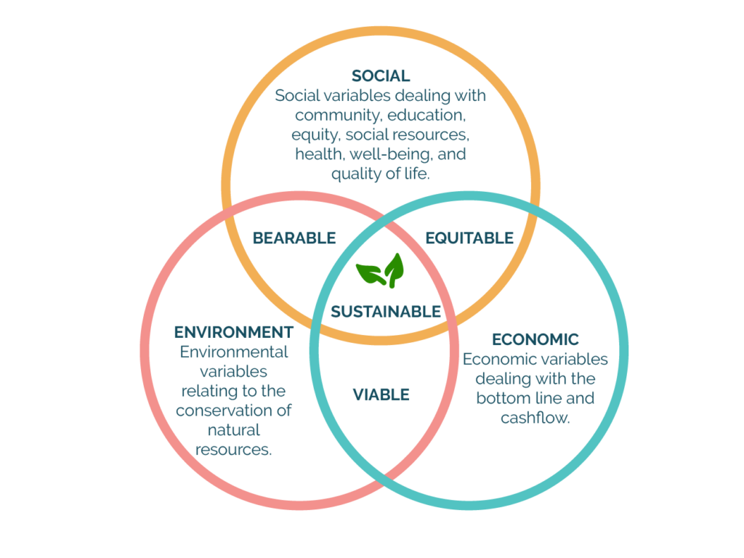

Slide 6


